Slide 1


Course :
AI Foundation for ALL
Instructors :
Alok Gupta
Mansi Jain

Slide 2
Machine Learning POVs in OPI
COB WOW Primacy Determination

Slide 3


Problem statement
Coordination of benefits is the practice of ensuring that insurance claims are not paid multiple times, when an enrollee is covered by multiple health plans at the same time. Under a COB provision, insurance companies share the burden without overpaying. COB determines which plan is primary and which is secondary. The primary plan will pay the claims first and the unpaid balance will be paid by the secondary plan to the limit of its responsibility.
Optum recovers ~40% of overpayments because of COB primacy issues. In 2017 ~$200 M recovered from COB cases
The ARO algorithms have true positive accuracy of ~40% (0.7 million members flagged as UHC not primary insurance in 2017), and to identify the true positives investigators has to go through all 100% inventory (1.7 million suspected members algo output) as per current prioritization process.
This delay of primacy determination, causes overpayment (incorrect payment) and hence need arises to recover in retrospective cycle

Slide 4
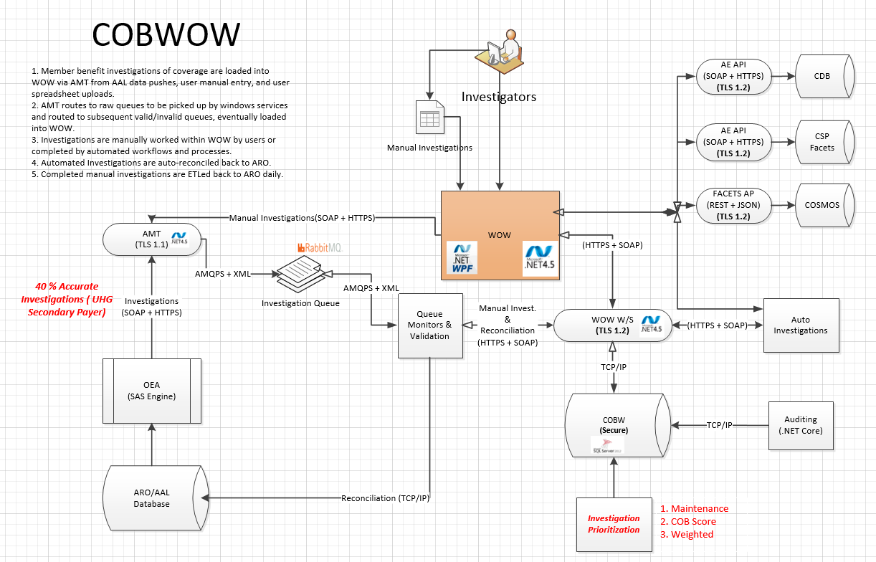
COB – WOW Primacy Determination(Current State)
Weight Based ~40 % Accuracy

Slide 5
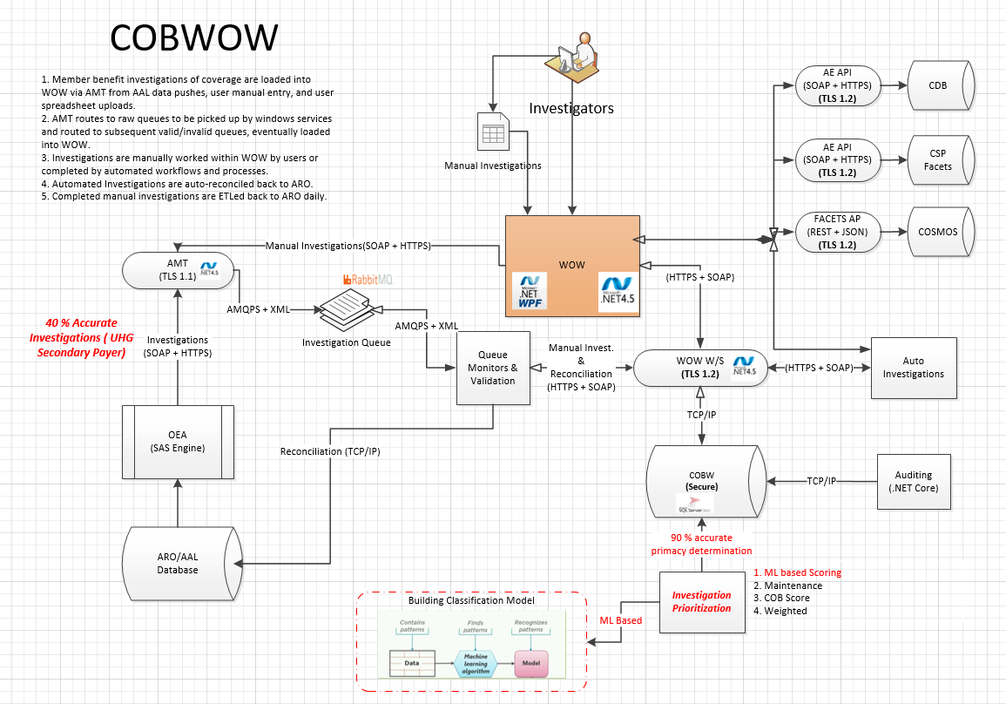
Proposed Machine Learning Approach
ML Based ~90 % Accuracy

Slide 6
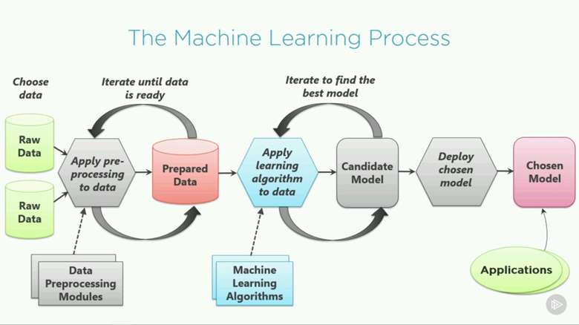
Proposed Machine Learning Approach :

Slide 7
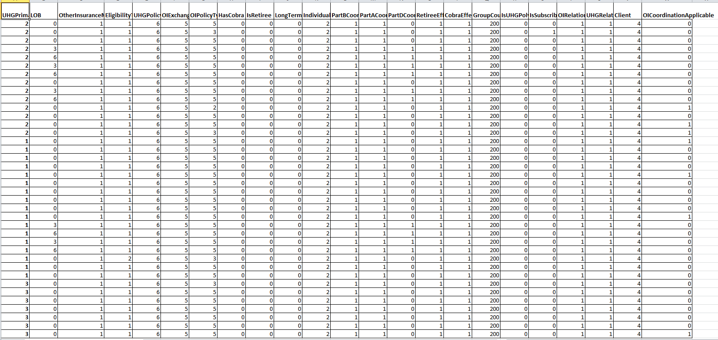

Prepared Features For Machine Learning:

Slide 8
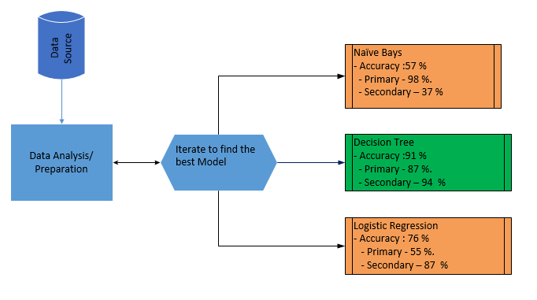
Steps Involved for Algorithm Selection
Algorithm Selection
Steps Involved :-
Based on opportunity select the data set
Work with SME to identify features
Identify correlated features
Work with SME to remove correlation
Identify contributing Features
Algorithm identification
Train the Model, review metrics
Deploy Model
Prediction on new dataset

Slide 9
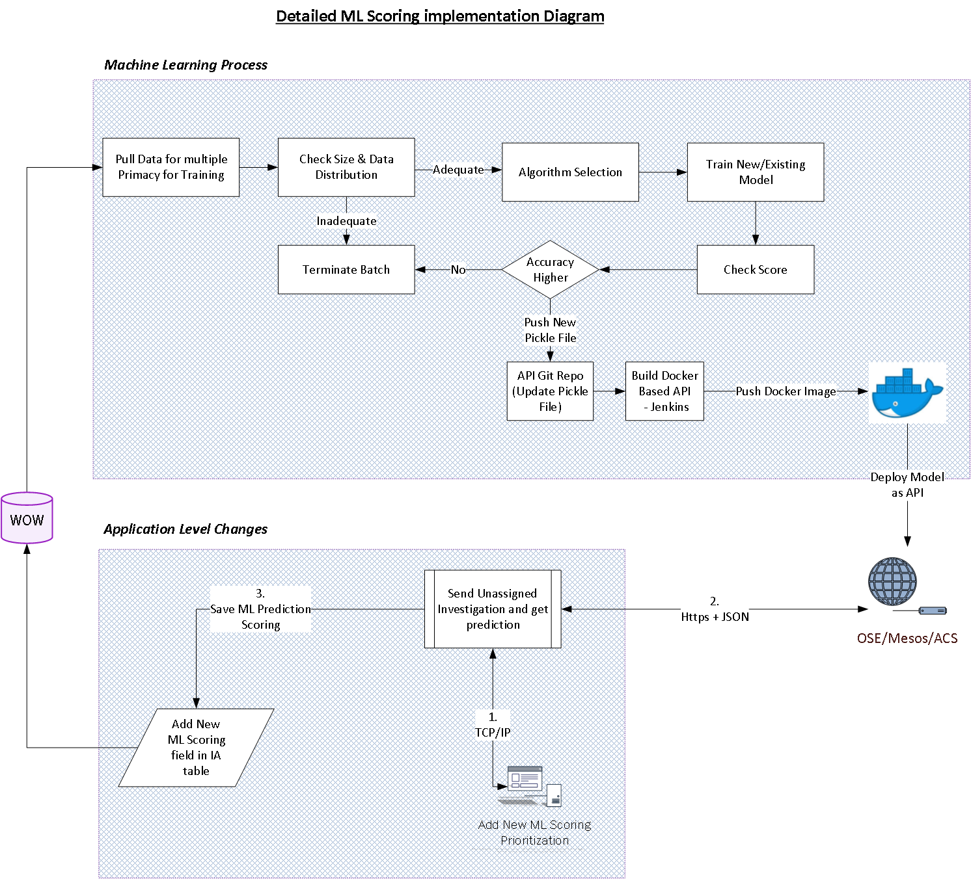
Detailed ML Scoring implementation Diagram

Slide 10
Technology Stack
Data Preparation and Feature Identification | SQL And Python
Algorithm building and Model Selection | Python
Serialization/Deployment of Model | PKL
API Building | Explored Flask, Python
Code Repository | Optum GitHub
CI/CD Pipeline | Jenkins Pipeline
Docker Repository | Optum Docker Registry
Deployment Environment | OSO Origin
Tools Used | Jupyter Notebook, SQL Server, Visual Studio 2017

Slide 11
Business Benefits
Increased accuracy of prioritization (weight base to ML ~40% to 90% Accurate)
Reduce the manual assignment effort
Users can work ~ 50% faster on positive member investigations so that more primacy determinations for member investigations. We get 8750 cases per day.
Prevent retrospective identification (Shift left ), ~ 50% of the overpaid claims are due to incorrect primacy. Thus have downstream impact on IDWS and ODAR
More Accurate data leads to engaged workforce

Slide 12
30-60-90 days plan post deployment
30 Days (17th September) :
- Continuously Monitor the prediction accuracy and Tune the model
60 days: (17th October)
- Pull the data for missed investigations.
- Assess downstream impact with IDWS and ODAR
- Share the report with Business Operations and work with Jen for the business adaption
90 days (17th November) Business adaption
- Rollout ML based prediction model in production
- Implementation of automated Continuous model training and monitoring

Slide 13
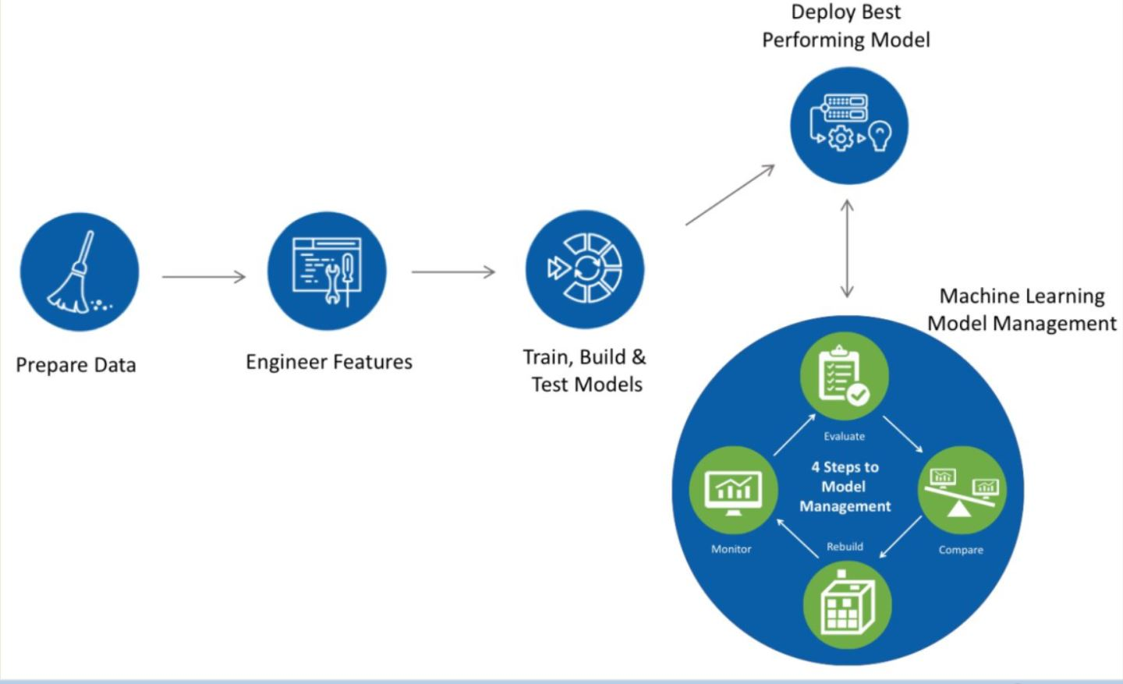
Model Management Cycle

Slide 14
Thank You

